Slide 1

AUTOMOBILE INDUSTRY

Slide 2

Roadmap
Indian Automobile Industry
Need for ERP in automobile industry
Maruti Suzuki India Ltd.– An Intro
Pre-implementation
Implementation strategies and transitions
Post-Implementation Benefits
Critical success factors
Future plans

Slide 3
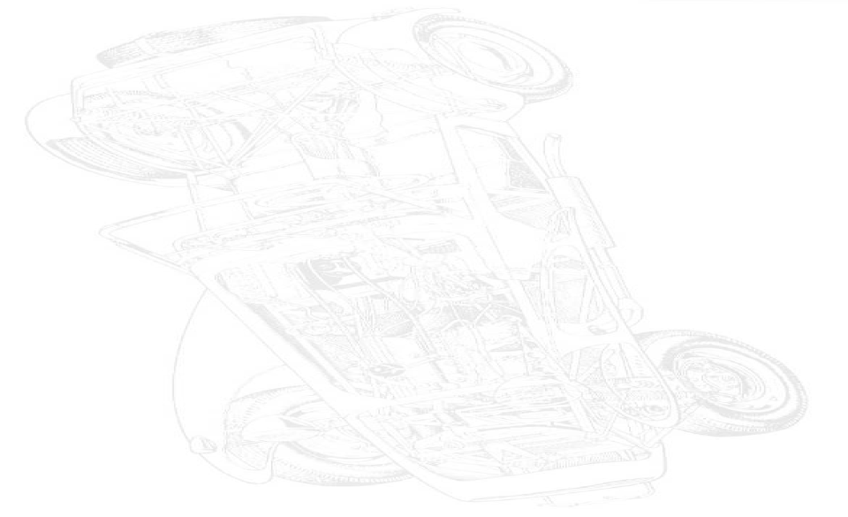
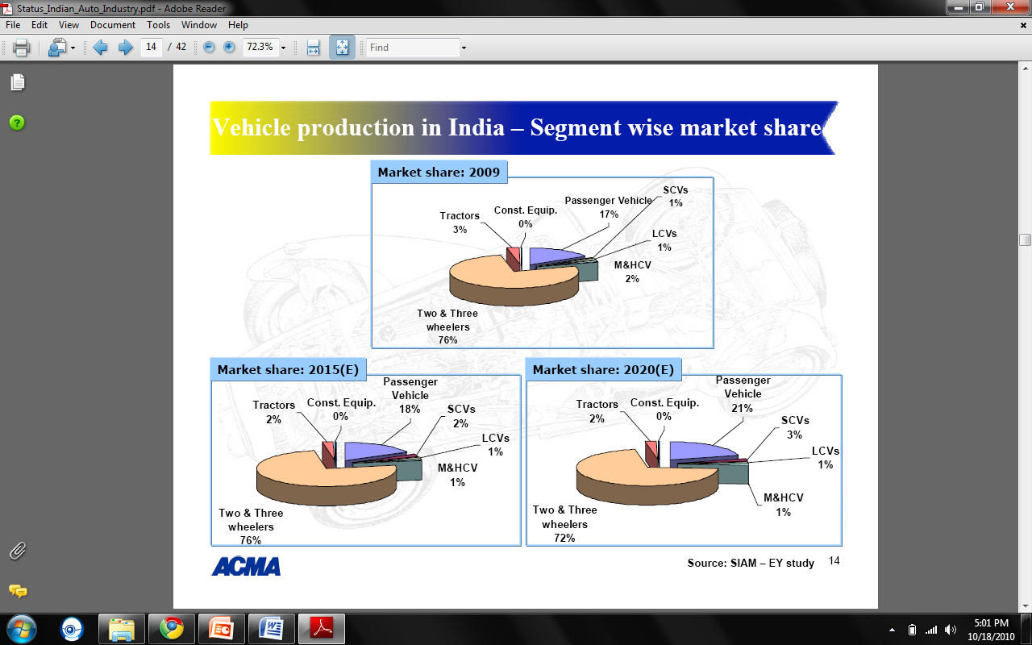
Indian Automobile industry
Seventh largest and second fastest growing automobile market in the world
Accounts for 5.2% of GDP
Annual production of 2.5 million units
Asia's fourth largest exporter

Slide 4


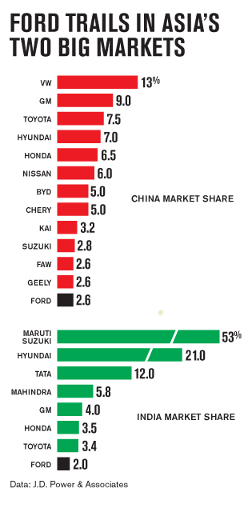


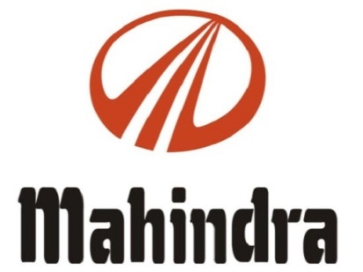



Major Players

Slide 5
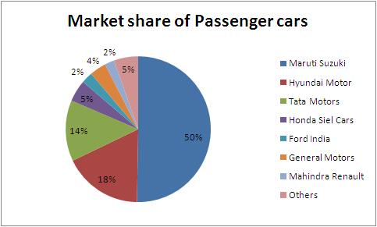
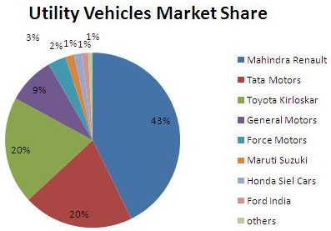
mArket share
Source: http://www.crisil.com/research/

Slide 6
Need for ERP in automobile industry
Integration of various value chain activities
Inventory Management
Controlling and monitoring of several projects simultaneously
Enterprise Visibility
Operational excellence & reduction in errors
Improved CRM & Real time information access

Slide 7

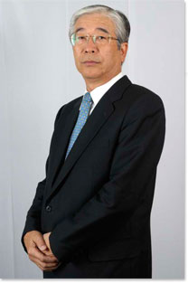
About maruti
Maruti Suzuki India Ltd.
Founded in | 1981 as Maruti Udyog Ltd
Subsidiary of | Suzuki Motor Corporation
MD & CEO | Mr. Shinzo Nakanishi
Annual Revenue | ` 260 billion (FY 2009-2010) approx.
Employee Strength | More than 7600
Product line | 14 Models and over 150 variants
Passenger Vehicles sold | 1 million units (FY 2009-2010) approx.

Slide 8
Business areas
Manufacturing and sale of motor vehicles and spare parts via a 300-strong dealer network scattered across India
In 2002
Finance
Leasing
Insurance
Pre-owned car

Slide 9
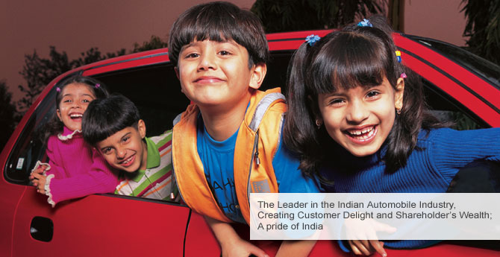
vision

Slide 10

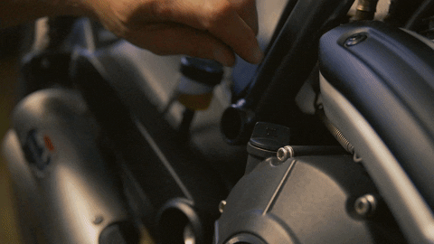
SERVICE

Slide 11
Problems
Home grown, disparate systems
Human Dependence
Lack of control over the processes
Poor information quality
Huge Turn-around time
No real-time access to information

Slide 12
Strategies for Erp implementation
Flexible and Expandable System
Standardized single Oracle Platform
Phased migration from legacy systems
Finance → Procurement → HR
Oracle consultants
Change Management
Project Management

Slide 13
Implementation process
Steering Committee
Project Planning
Employ Oracle’s Business Flow Accelerators
Quality Control Team
Regular system review to ensure delivery of requested functionality

Slide 14
Smooth transition
Process Changes
Training programs
User manuals
Train-the-trainer program
Train the Super users
Oracle Certified Advantage Partner IBM
3-months Post-implementation support

Slide 15
Indian automobile sector is in a growth phase.
It all started mainly due to liberalization, privatization and
globalization of Indian economy.
Today Indian car manufacturers are able to manufacture cars that
are able to meet global standards.
This is a study to know about the customer’s perception towards
MARUTI SUZUKI one of the oldest and
strongest market player in India.

Slide 16

benefits

Slide 17
Financial insight
Standardization provided tight control over
Accounts payable
Accounts receivable
Comprehensive general ledger
Greater efficiency & less confusion
Year-end and month-end closing on time

Slide 18
hyperion
Analyze budgets across 9 subsidiaries
Compliance with GAAP
Deeper insight of the performance
Alerts possible problems
Improved accuracy of forecasts
Oracle’s acquisition of Hyperion

Slide 19
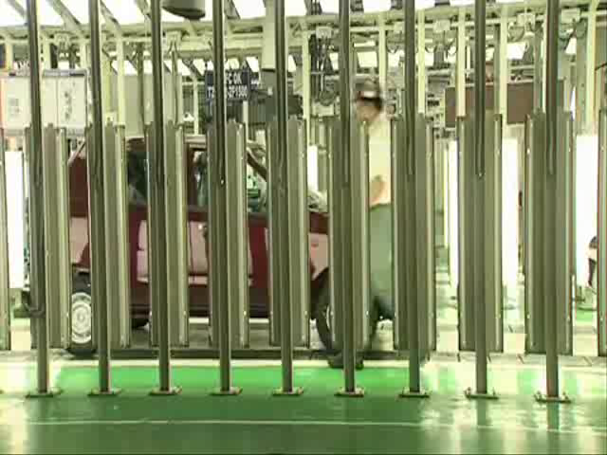
hyperion

Slide 20
Procurement
Removal of rudimentary systems and spreadsheets
Cost reduction and inventory management
Decrease in no. of vendors
Automated workflow

Slide 21
Hr workforce mgmt.
Better control over processes
Recruitment
Payroll
Compensation and leave management
Competency assessment
Staff development
Complete personal and work history in a single Database
Attract and retain high quality people

Slide 22

HR MODULE

Slide 23
Enterprise
Proper integration
Among various departments
With legacy systems
Lower support costs
Easy upgrades in the future
End-to-end visibility

Slide 24
Critical success factors
Support of Business Users
Robust Change Management
Project Management
Phased Implementation
Extensive user training
Proper integration with existing processes

Slide 25
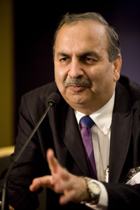
With Oracle Consulting, we got a total solution – a partner with end-to-end responsibility for developing, installing, and supporting the solution.”
Rajesh Up
Chief GM- IT

Slide 26
Future plans
Advanced SCM
Oracle Enterprise Asset Management
Total integration using Oracle
Automation of SCM

Slide 27
Annexure
Chairman Message.pdf
Directors Report.docx
Financial-Result-09-10.pdf
Income Statement

Slide 28
REFERANCE
ACMA(Automotive Component Manufacturers Association of India)
www.marutisuzuki.com
www.youtube.com
www.oracle.com

